Slide 1


The Mantid Project:
Notes from an international software collaboration
Nick Draper
Tessella

Slide 2
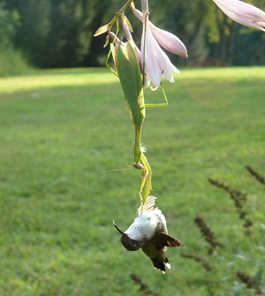
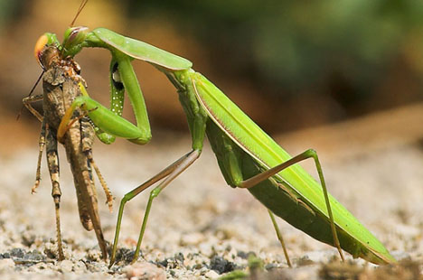
Overview
Why collaborate?
Collaboration Models
ISIS - SNS & HFIR collaboration
  Organisation
  Benefits
  Lessons Learned

Slide 3
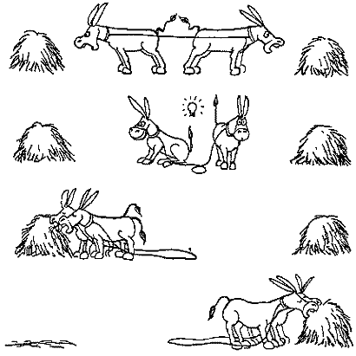
Collaboration Benefits
Why Collaborate?
  Solve big problems
  Cover a wide scope
  ↑ access to skills and talents
  Reduce costs
  Access to existing code
  Improved support
All parties should benefit

Slide 4
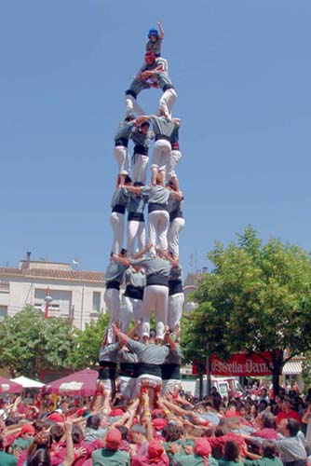
Collaboration Challenges
Why Collaborate?
  Larger development team
  ↑ induction
  ↑ communication
  ↑ project structure
  Generic solutions take time
  ↑ documentation
It is important to minimise these effects

Slide 5

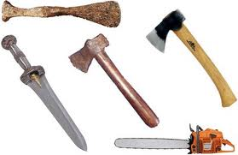
Collaboration Models
Many possible models
Several used within Mantid
  Open contributions - Informal Anarchy
  User donated code
  Joint distributed team
  Application integration
Pick the right tool for the job

Slide 6

Open Contributions - Informal Anarchy
Key Features
  People choose their own priorities
  Anyone can submit code
  Immediately available to all
Advantages
  Very lightweight
Drawbacks
  Negative effect on quality
  Likely to repeat work
Use in Mantid
  User script library

Slide 7

User donated code
Key Features
  Users submit code to the dev team
  Dev team adopt the code
    Review & Refactor
    Test
    Document
Advantages
  High quality additions to functionality
Drawbacks
  Significant dev team involvement
Use in Mantid
  User supplied algorithms and key scripts

Slide 8
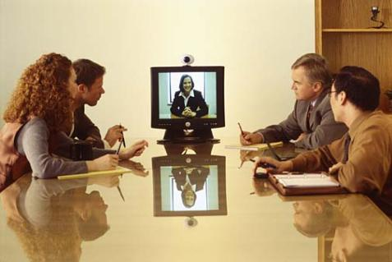
Joint distributed team
Key Features
  Single project management lead
  Geographically separated, but joint
  dev teams
Advantages
  Consistent, planned development
  Increased support hours
Drawbacks
  Increased communication
  Initially introduction of a whole dev team
Use in Mantid
  ISIS – SNS Development

Slide 9

Application integration
Key Features
  Integration with well known tools
  Smooth transfer to/from Mantid
  Rapid increase in functionality
Advantages
  Can be simple file format support
  Avoids reinventing the wheel
Drawbacks
  Imperfect user experience
  Lack of direct control
Use in Mantid
  GSAS, Fullprof & other tools

Slide 10
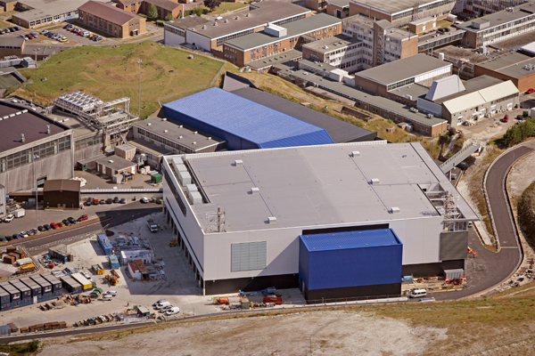
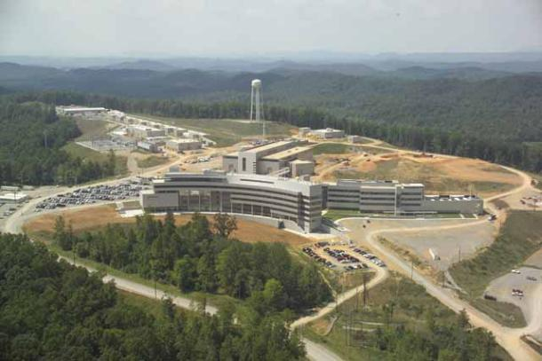
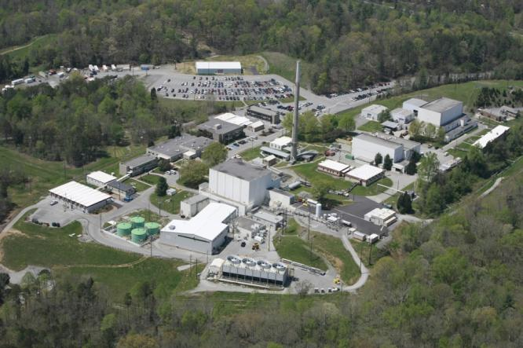
ISIS - SNS & HFIR collaboration

Slide 11
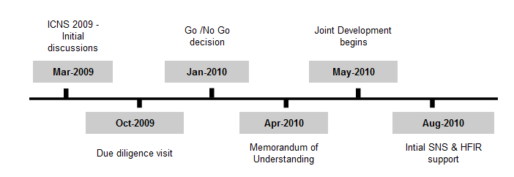
SNS Collaboration Timeline
14 Months

Slide 12
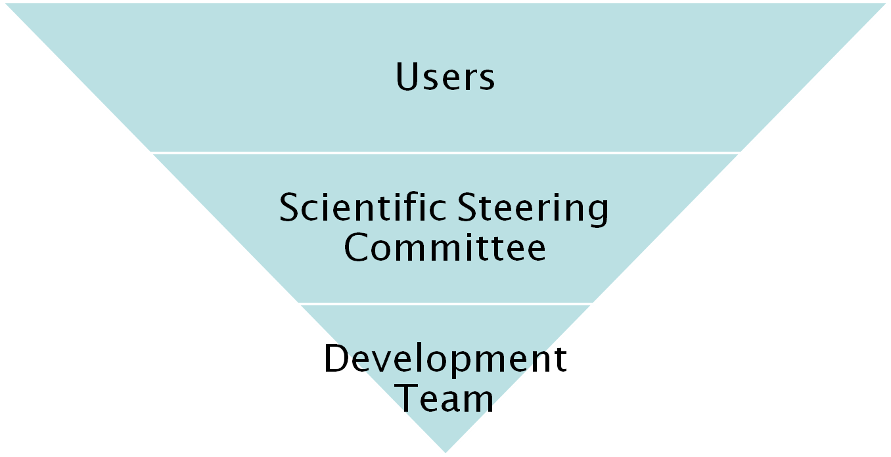
Original Project Organisation
27 beamlines, 1600 users
9 Key scientists representing every beamline.
PM &
7 Developers
Project Management Board

Slide 13
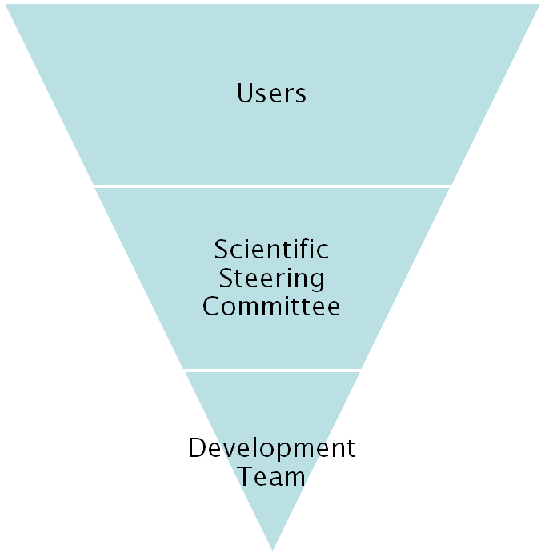
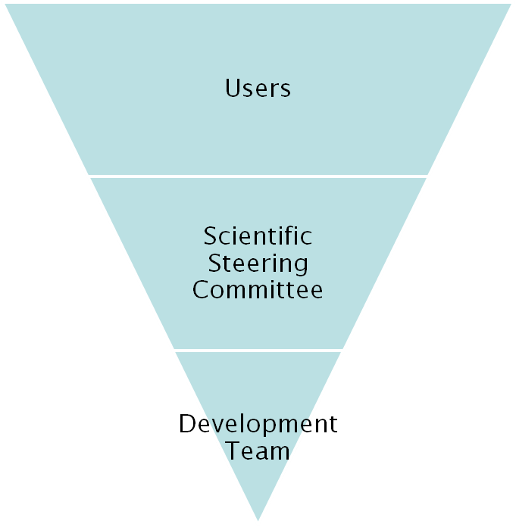
Project Organisation
ISIS
SNS/HIFR
27 beamlines, 1600 users
26 beamlines, 850 unique users
9 Key scientists
4 Key scientists
PM &
16 Developers
Project Management Board

Slide 14



Continuous Integration Environment
Deploy to
Download site
Mantid Project Wiki
Automated
System test
SVN
Repository
Build + unit test
-RHE 5 & 6
-Ubuntu
-Mac OSX
-Windows 32
-Windows 64
trac
Issue
tracking
system
Developers

Slide 15


Communication
Face to face meetings
  PM 3-4yr
  Developer visit program
  Developer workshops
Developer Transfer
  ISIS lead developer transferred to US
Easy communication channels
  Developer email list
  Skype
  Phone
  Screen sharing
  Video conferencing

Slide 16
ISIS -> SNS wins
Robust framework
  Common development structure
  Multithreaded performance
  Documentation and training
  Automated build, test and deployment
Algorithms
  Over 100 algorithms already developed
Development support
  help

Slide 17
SNS -> ISIS wins
Improvements to build process
  Cmake, Hudson
Event Workspaces
Event Filtering
  Currently by time
  Will expand
Improved python code framework
New file format support
  NxSPE
  Event Nexus

Slide 18
Lessons Learned
Developer documentation
  Need to rapidly induct several new developers
  Will not be good enough
Communication
  Has to be encouraged
  Will take some time
Personal relationships
  Are key to working together in a team
High level support is essential
No two facilities are the same
  Archive structure
  Information catalog

Slide 19
Lessons Learned
Minor irritations
  You may have learned to live with them
  Will be much more irritating to new developers
    Make use of this enthusiasm
Development Environments
  Will differ across facilities
  Set up can be painful
  Don’t let issues linger
Design
  Consider implications
  Design for flexibility

Slide 20
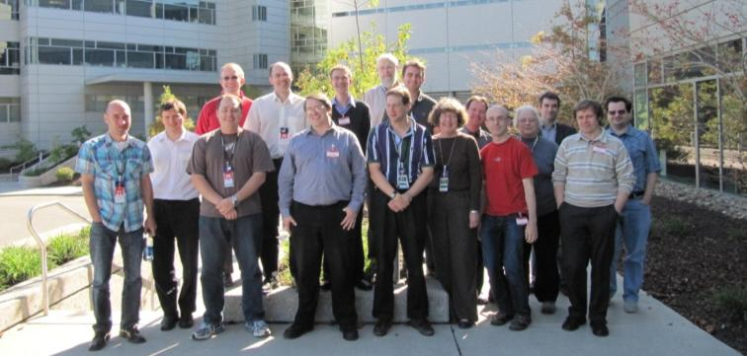
Conclusions
Collaboration lets you tackle more / bigger problems
Choose the right model
Make sure everyone benefits
Communication is key
Train the new team
  Consider transfers

